Slide 1
CRUDE OIL PRODUCTION INSIGHTS IN THE UNITED STATES
Olatomi Adigun
Notes:
Hi My name is Olatomi Adigun and I will be sharing my findings on the intricacies of crude oil production in the United States.

Slide 2
01
Introduction
02
DataSet
CONTENTS
03
Analysis
04
Conclusion
05
Reference

Slide 3
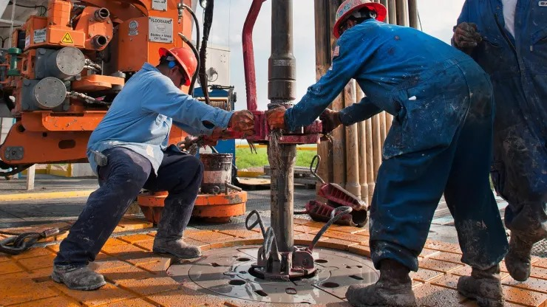
INTRODUCTION
Importance of Crude Oil production to USA
Purpose of Analysis
Notes:
Crude oil production is essential to the USA's economy, driving economic growth and ensuring energy security. In this analysis, we'll delve into key trends and insights shaping the landscape of crude oil production in the USA

Slide 4

Dataset
Source: U.S. Energy Information Administration (EIA)
Variables: Year, Product, State, Production Volume,
Preprocessing: Data retrieved via EIA API, cleaned, transformed, and merged
Notes:
My analysis is based on data sourced from the U.S. Energy Information Administration (EIA). . I accessed the data via the EIA's API and conducted thorough data cleaning, transformation, and merging to ensure accuracy and reliability. I then examined variables such as the year, product, price, state, and production volume for the anlaysis

Slide 5
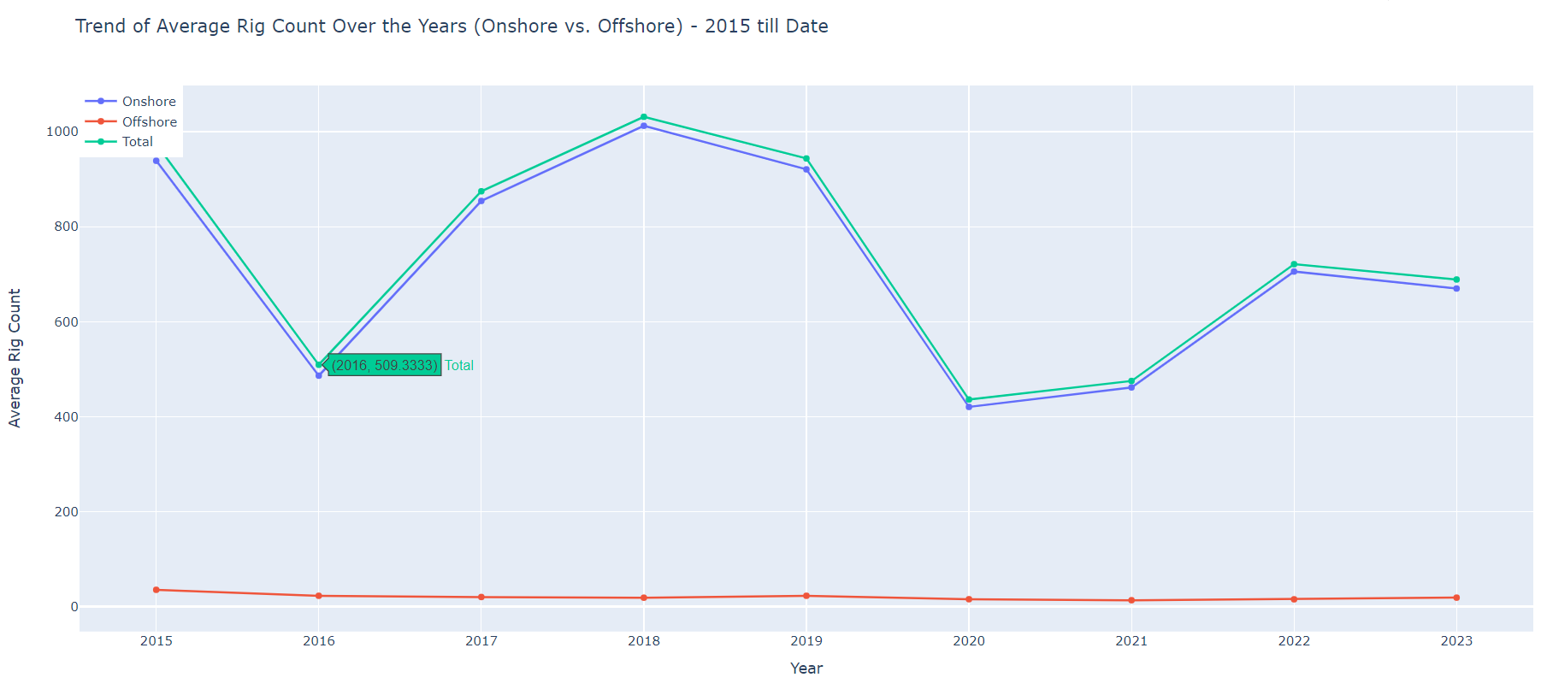
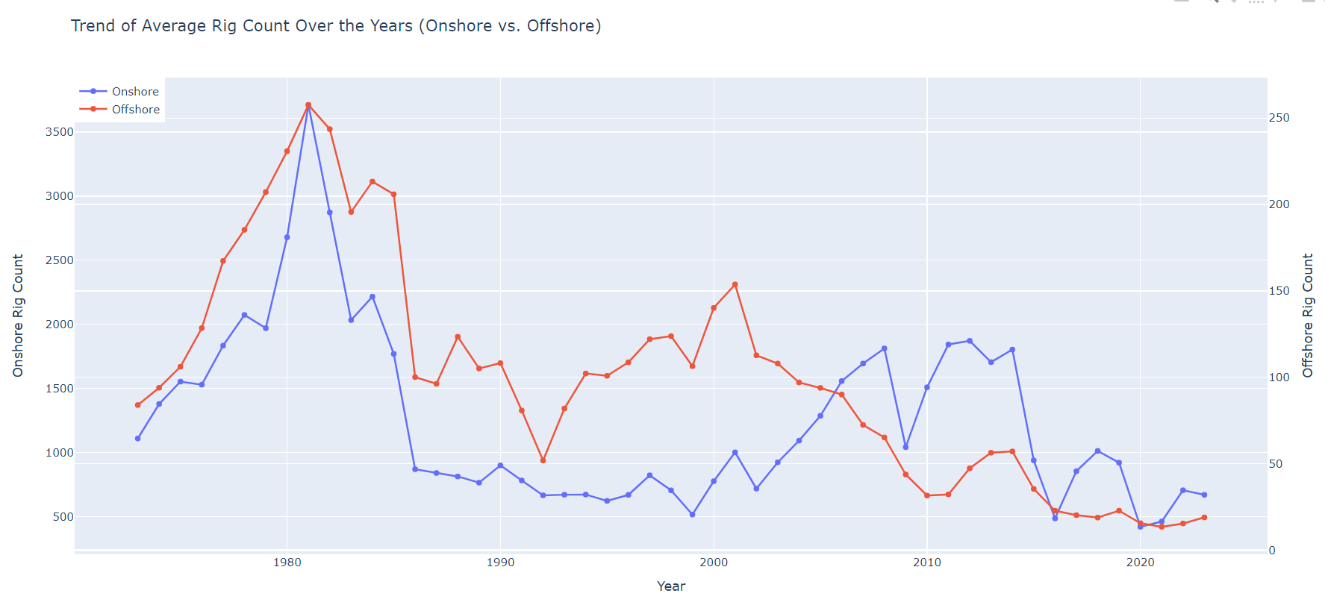
Analysis 1- How has the rig count varied over the years, and what is the trend for onshore vs. offshore rigs?
Flunctuations in
Rig Counts
Correlation between Offshore Rig count
and Onshore Rig
count
Notes:
First, Looking at rig count trends, I observed significant fluctuations over the years, with dips in 2016 and 2020 . These downturns coincided with major economic and social events, such as the oil price crash in 2016 and the COVID-19 pandemic in 2020.
I also observed a clear correlation between offshore and onshore rig counts, suggesting that economic and industry-wide factors influence both onshore and offshore drilling activities in tandem.

Slide 6
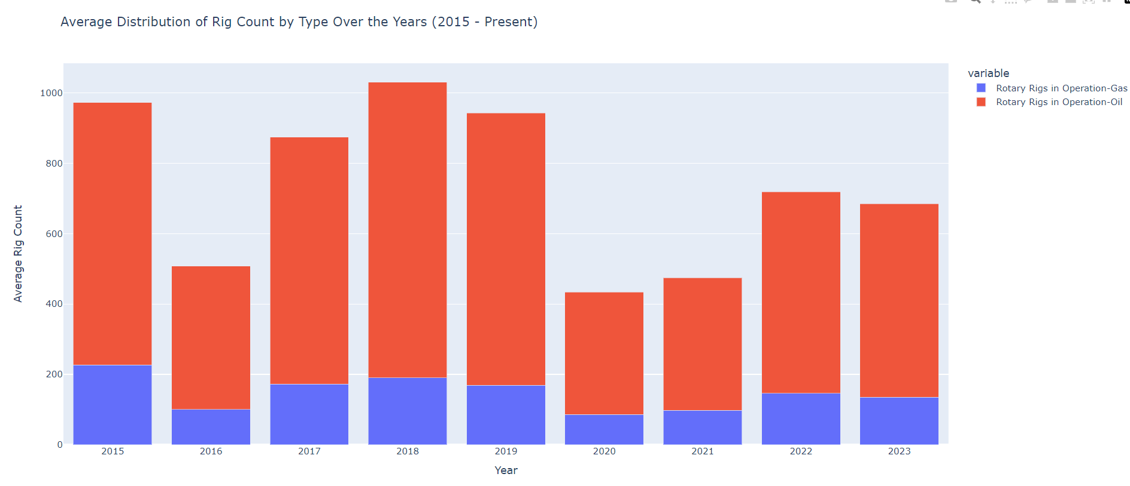
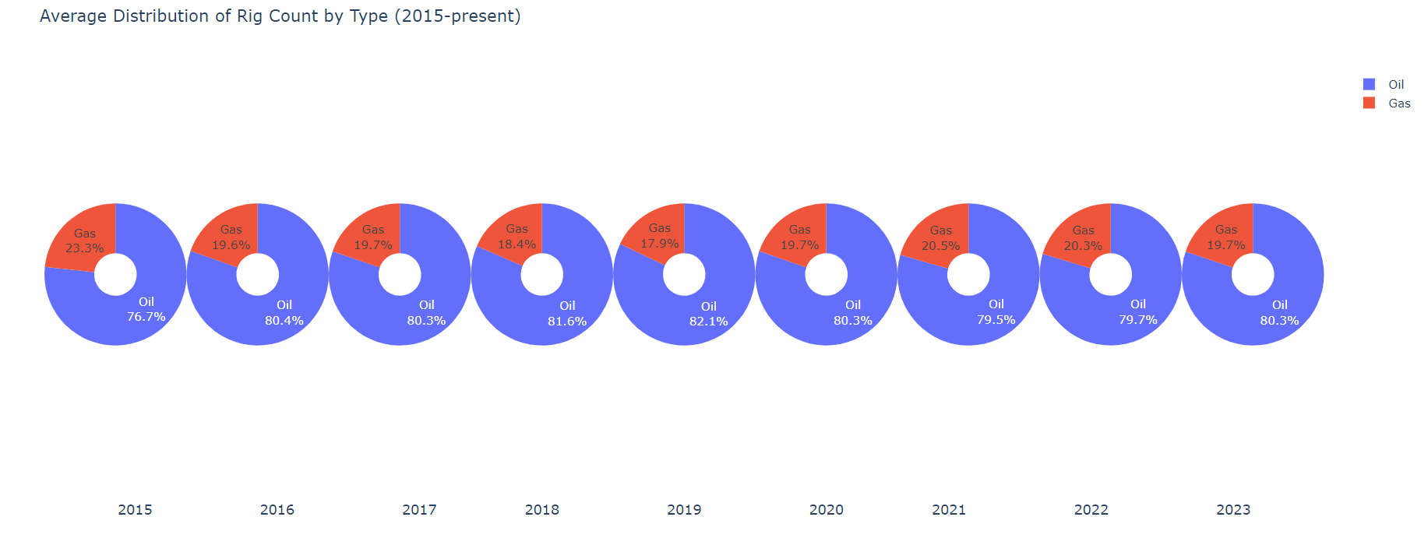
Analysis 2: What is the distribution of rig count by type (oil vs. gas) over the years?
Flunctuations in
Rig Counts
Rig Ratio Stability with Oil and Gas
Locations
Notes:
Exploring rig count distribution by energy type oil or gas, I noted the same as the first analysis, where the distribution of rig counts between oil and gas rigs varied over the years, reflecting fluctuations in the energy industry and market dynamics.
Despite these fluctuations, the ratio of oil to gas rigs has remained relatively stable over time with oil rigs were approximately four times more prevalent than gas rigs throughout the analyzed period

Slide 7
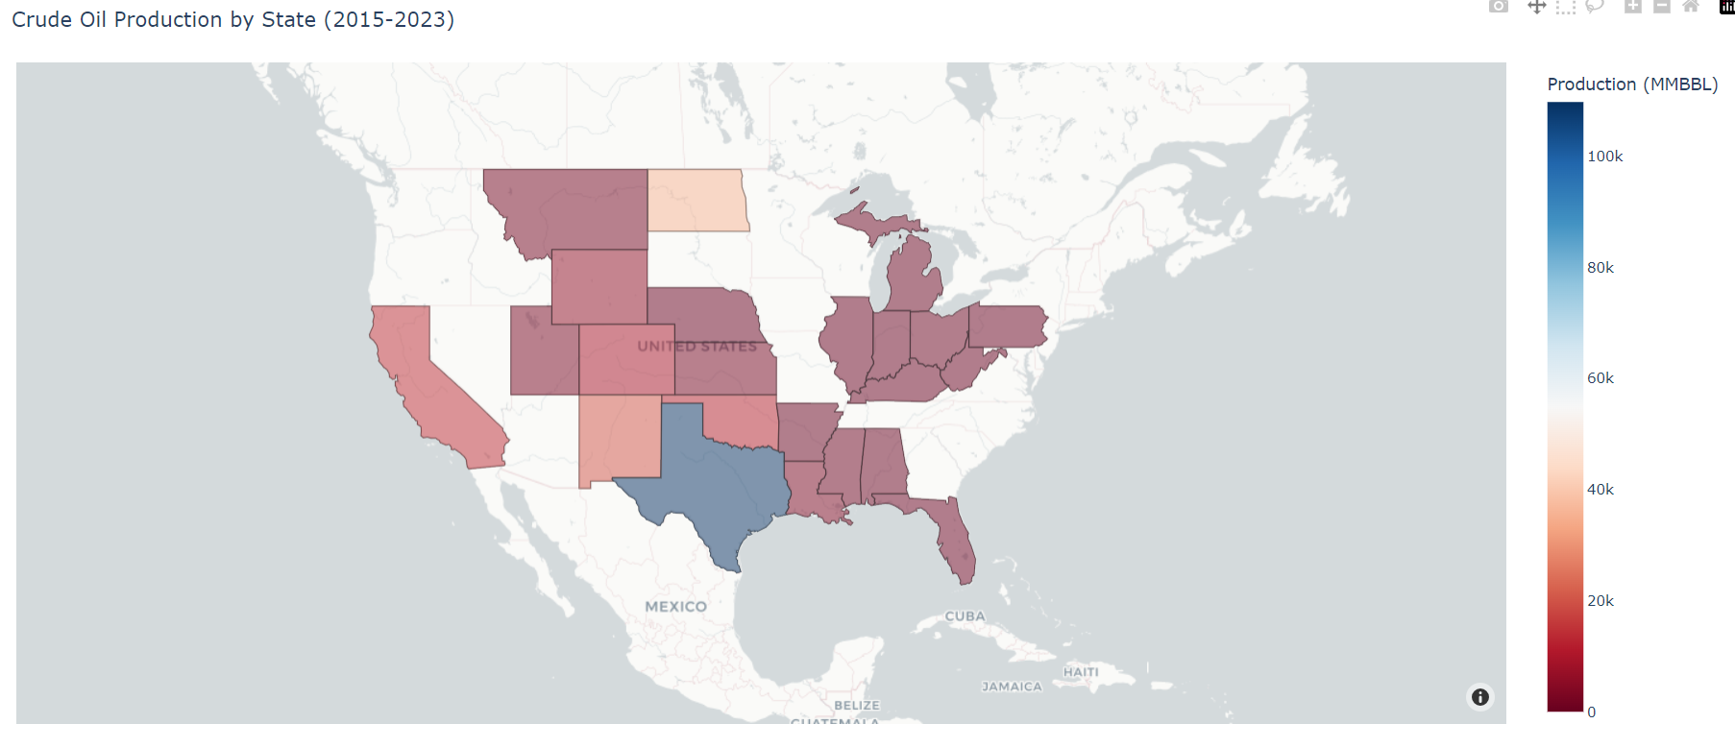
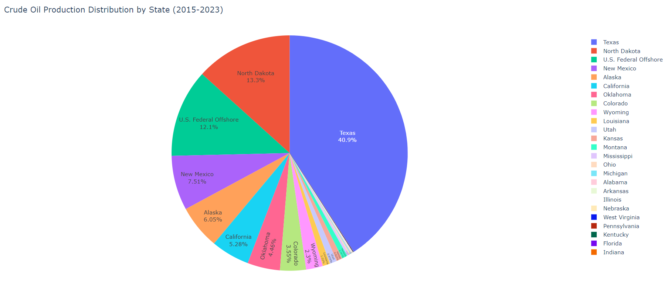
Analysis 3: How does crude oil production vary across states, and what are the top producing states?
Geographical clustering
indicates regional
production hubs.
Top three states (Texas,
North Dakota, Gulf of
Mexico) contribute
two-thirds of total US
production.
Texas leads with 40.9% of
the nation's oil production.
Notes:
Our analysis of crude oil production across states revealed fascinating insights. Geographical clustering suggests regional production hubs, with Texas, North Dakota, and the Gulf of Mexico emerging as top contributors, collectively accounting for two-thirds of total US production. Notably, Texas leads the pack with a commanding 40.9% share.

Slide 8
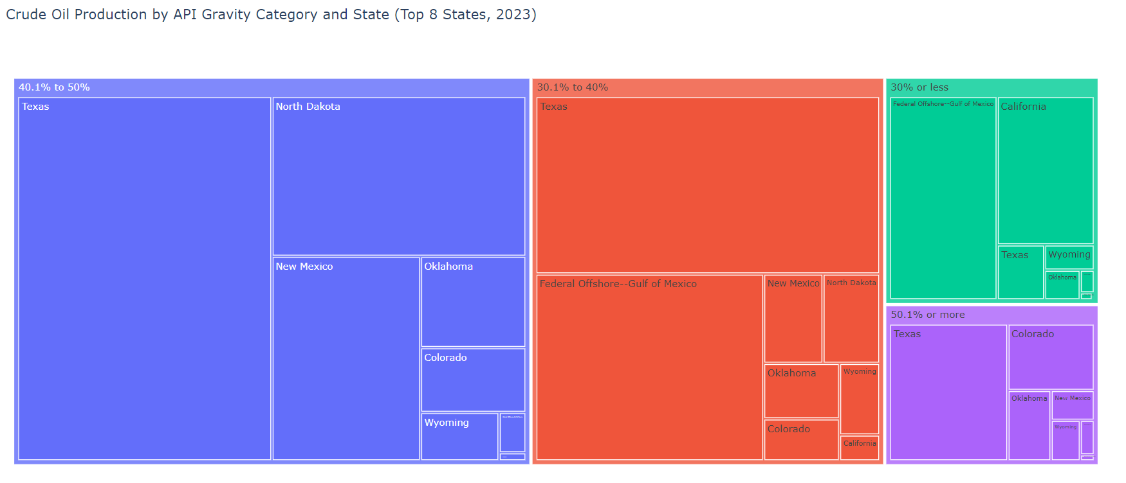
Analysis 4: What is the relationship between API gravity and crude oil production per day, and how does it vary by state?
Most production falls in the 40.1% to 50%
range.
Texas leads in most of the categories
Higher prevalence of 30% or less in Gulf of Mexico.
Notes:
Exploring the relationship between API gravity State and production, we found that 40.1% to 50% range constitutes the highest proportion. Texas's dominates across various gravity categories except for the 30% or less category, which is prevalent in the Gulf of Mexico region.

Slide 9
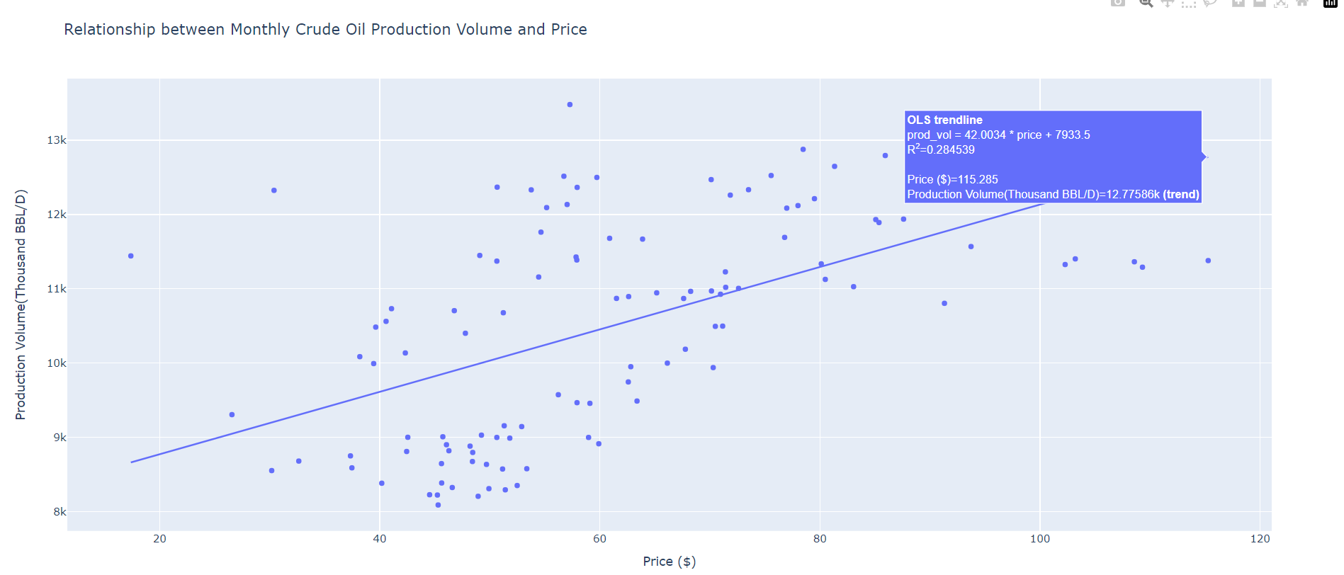
Analysis 5: How Does Crude Oil Production Relate to Price Fluctuations?
Moderate positive correlation observed.
Regression:
prod_vol=42.0034price + 7933.5
R2 : 0.28, explaining 28% variance.
Notes:
Finally, I analyzed the relationship between the production-price relationship. It reveals a moderate positive correlation between crude oil production and price fluctuations. Through regression analysis, I derived a predictive model indicating that for every $1 increase in price, crude oil production increases on the average by 42.0034 thousand barrels/day. However, the model's R2 of 28% indicates it explains only a portion of the variance

Slide 10
Conclusion
Rig Counts: Resilient amid economic shifts, onshore and offshore counts correlate.
Rig Distribution: Stable oil-to-gas ratio reflects market preferences.
Production by States: Texas dominates, regional concentrations vary.
API Gravity Impact: Texas influences production across gravity categories.
Production-Price Relationship: Moderate correlation highlights price influence.
Notes:
In conclusion:
Rig Counts have shown resilience amid economic shifts, with a clear correlation observed between onshore and offshore counts.
Rig Distribution indicates a stable oil-to-gas ratio, reflecting market preferences and industry dynamics.
Production by States reveals Texas as the dominant player, while regional concentrations vary across the United States.
API Gravity significantly impacts production, with Texas influencing production across various gravity categories.
The Production-Price Relationship demonstrates a moderate correlation, highlighting the influence of price fluctuations on crude oil production.
These insights are crucial for understanding and navigating the complexities of the crude oil production landscape in the United States.

Slide 11
References
Api dashboard—U. S. Energy information administration(Eia). (n.d.). Retrieved February 14, 2024, from https://www.eia.gov/opendata/browser/index.php
USA states GeoJson. (n.d.). Retrieved February 14, 2024, from https://www.kaggle.com/datasets/pompelmo/usa-states-geojson
Notes:
These are my references

Slide 12
THANK YOU
Notes:
For more details you can visit the website .Thank you for your attention.

